Slide 1
Online Complaint Registration And Management System
Team Members :
ROHINI E
SAMUELA V CATHERINE
SANJANA B
SARA PRICILLA A

Slide 2
ABSTRACT
The Online Complaint Registration and Management System is an innovative software solution designed to enhance the efficiency and effectiveness of complaint handling processes for individuals and organizations. This model used React for the frontend, used in the client side, Express, MongoDB, and Node.js environment for the backend, and REST APIs tested using Postman API. This system provides a centralized platform that enables users to easily submit complaints, track their progress in real time, and communicate with assigned agents for resolution. Key functionalities include automated notifications, intelligent complaint routing, and robust security measures, all aimed at ensuring timely and secure handling of issues. By streamlining complaint management, this system not only improves operational workflows but also fosters customer satisfaction and compliance with industry regulations. Ultimately, the implementation of this system equips organizations with the tools necessary to proactively address concerns, thereby enhancing their safety management systems and overall service quality.

Slide 3
INTRODUCTION
In today’s fast-paced digital landscape, effective complaint management is crucial for organizations seeking to maintain customer satisfaction and uphold their reputation. The Online Complaint Registration and Management System addresses this need by providing a centralized platform that simplifies the process of submitting, tracking, and resolving complaints. Designed for both individuals and organizations, this system empowers users to report issues seamlessly and interact with dedicated agents throughout the resolution process. By incorporating features such as automated notifications, intelligent routing, and robust security protocols, the system not only enhances operational efficiency but also ensures compliance with industry regulations. Ultimately, this project aims to revolutionize the complaint handling process, fostering transparency, accountability, and improved service quality in a user-centric manner.

Slide 4
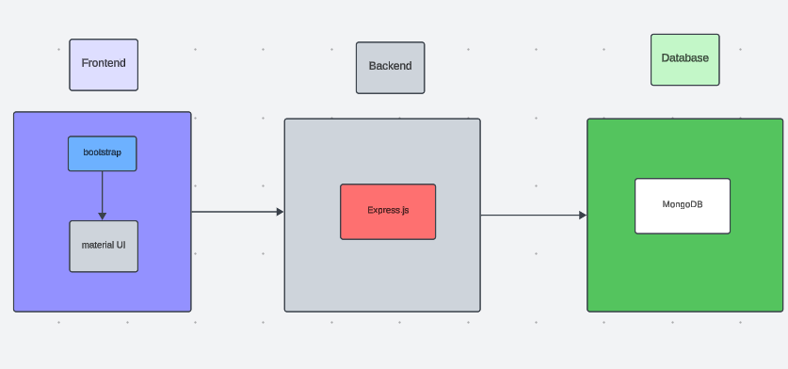
ARCHITECTURE DIAGRAM

Slide 5
PROPOSED SYSTEM
The Online Complaint Registration and Management System is designed to streamline the complaint handling process through a centralized, user-friendly platform. Key features include:
User-Friendly Interface: Simplifies the complaint submission process for users.
Real-Time Tracking: Allows users to monitor the status of their complaints instantly.
Automated Notifications: Keeps users informed of updates and resolutions.
Intelligent Routing: Directs complaints to the appropriate agents based on predefined criteria.
Enhanced Security: Protects user data and ensures compliance with regulations.
This system aims to improve response times, increase transparency, and enhance overall customer satisfaction.

Slide 6
FRONTEND
The frontend of the Online Complaint Registration and Management System is developed using React, a powerful JavaScript library that provides a dynamic and responsive user interface. React's component-based architecture allows for the creation of modular and reusable components such as user registration, complaint submission, status tracking, and the admin dashboard. This structure ensures scalability and ease of maintenance. The system features real-time form validation and responsive design, offering a smooth user experience across various devices. Efficient state management ensures that user interactions, such as registering complaints and tracking their progress, are updated instantly without the need for page reloads. React also integrates seamlessly with the backend via RESTful APIs, enabling real-time data fetching and updates. Overall, the React-based frontend delivers an intuitive, user-friendly interface that enhances both user engagement and system efficiency.

Slide 7
BACKEND
The backend of the Online Complaint Registration and Management System is built using Express, Node.js, and MongoDB, ensuring a scalable and high-performance system. Express.js simplifies routing and request handling, allowing users to register, log in, submit complaints, and check statuses seamlessly. Node.js ensures non-blocking, asynchronous operations, providing a responsive system under heavy loads.
MongoDB serves as the database, storing user complaints, registrations, and statuses in a flexible and scalable way. Its document-based structure is ideal for managing dynamic user data and supports efficient retrieval and updates. RESTful APIs enable smooth communication between the frontend and backend, handling key operations like complaint submissions and status updates. This tech stack ensures a robust, fast, and secure backend to support the system's functionality.

Slide 8
INTEGRATION
The Online Complaint Registration and Management System integrates the React frontend with the Express, Node.js, and MongoDB backend through seamless communication enabled by RESTful APIs. The frontend, built with React, interacts with the backend to handle user requests such as complaint registration, status tracking, and user management.
Express serves as the server framework, managing API routes that facilitate the exchange of data between the client and the database. The Node.js backend processes these requests asynchronously, ensuring efficient and non-blocking data flow, while MongoDB stores and retrieves complaint data in real-time.
To ensure smooth integration, Postman was used for API testing, validating that all RESTful endpoints for creating, reading, updating, and deleting complaints function as expected. This testing ensured that data transfer between the frontend and backend is accurate, secure, and efficient, providing a reliable user experience. The integration of these technologies ensures a robust system for handling user complaints and management tasks efficiently.

Slide 9
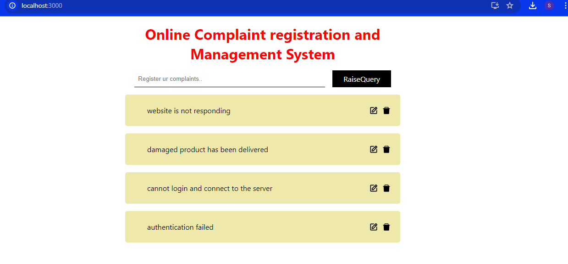
MODEL

Slide 10
CONCLUSION
The Online Complaint Registration and Management System represents a significant advancement in how organizations handle customer grievances. By providing a centralized, user-friendly platform, it enhances the efficiency of complaint resolution processes, promotes transparency, and improves customer satisfaction. With features such as real-time tracking, automated notifications, and intelligent routing, the system not only addresses the immediate needs of users but also supports organizations in maintaining regulatory compliance and protecting sensitive data. As it evolves, future enhancements like AI analytics and mobile accessibility will further optimize its capabilities, ensuring that both users and organizations can navigate the complaint process effectively and foster a culture of continuous improvement. Ultimately, this system empowers organizations to turn challenges into opportunities, enhancing overall service quality and customer loyalty.

